Slide 1

Active NeRF
Minjae Lee

Slide 2
Why Need?
It has been proved in PixelNeRF that NeRF fails to generalize well from one or few input view.
NeRf framework tend to collapse to trivial solutions by predicting the volume density as 0 for the unobserved regions.

Slide 3
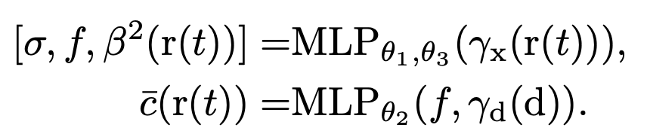
How consider Uncertainty?
Propose to model the emitted radiance value of each location in the scene as a Gaussian distribution instead of a single value.
define the radiance color of a location r(t) follows a Gaussian distribution parameterized by mean c ̄(r(t)) and variance β ̄2(r(t)).
Softplus function adopted

Slide 4

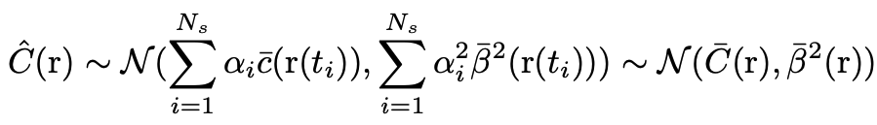
How consider Uncertainty?
If we denote the Gaussian distribution of a potition at r(t) as
, the rendered value along this ray naturally follows Gaussian distribution:

Slide 5
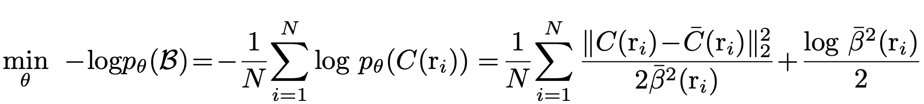
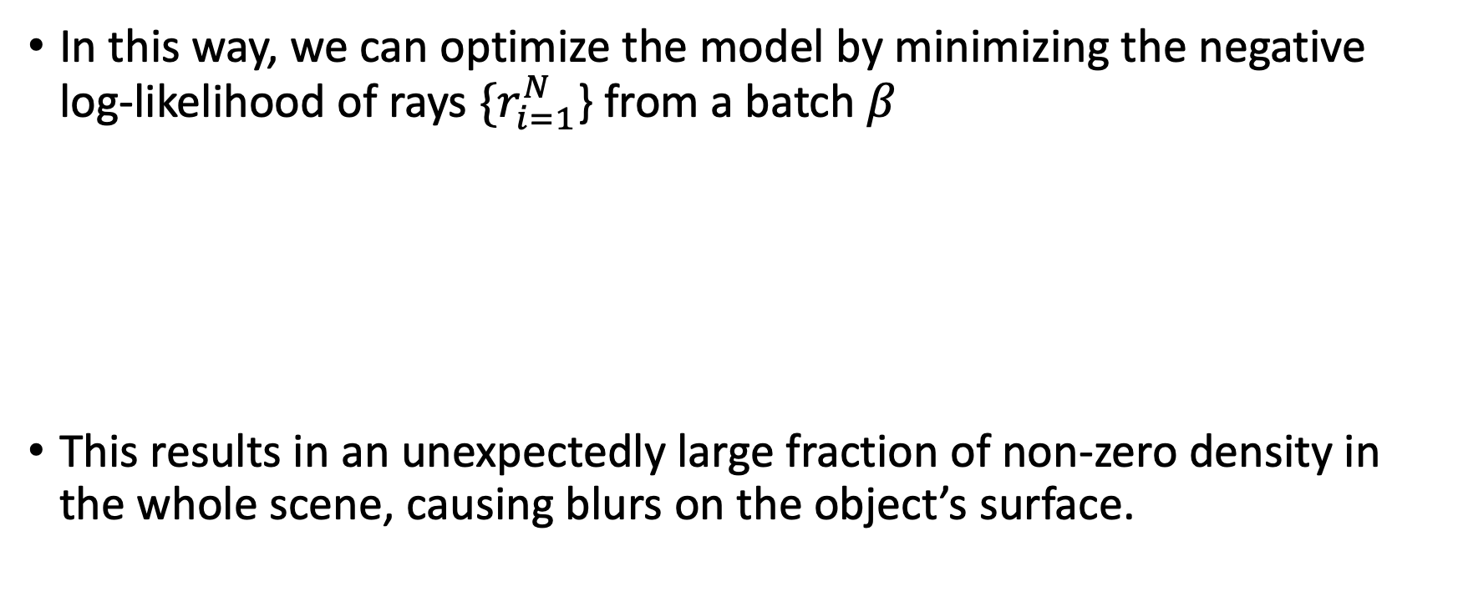
How consider Uncertainty?
In this way, we can optimize the model by minimizing the negative log-likelihood of rays ${\{r}_{i=1}^{N}$} from a batch $β$
This results in an unexpectedly large fraction of non-zero density in the whole scene, causing blurs on the object’s surface.

Slide 6
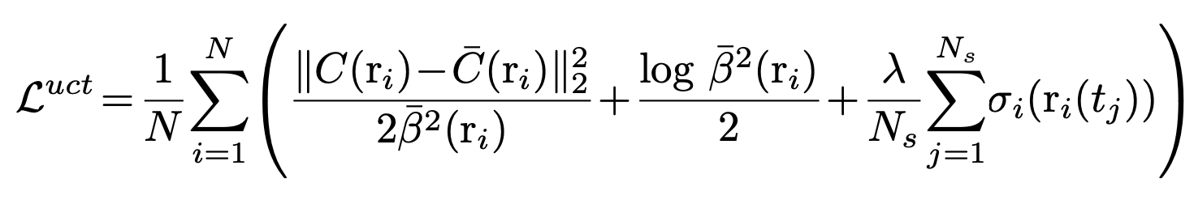
Additional Term
Therefore, we add an additional regularization term to force sparser volume density, and the loss function is formulated as:
Notes:
람다는 하이퍼 파라미터이다.

Slide 7
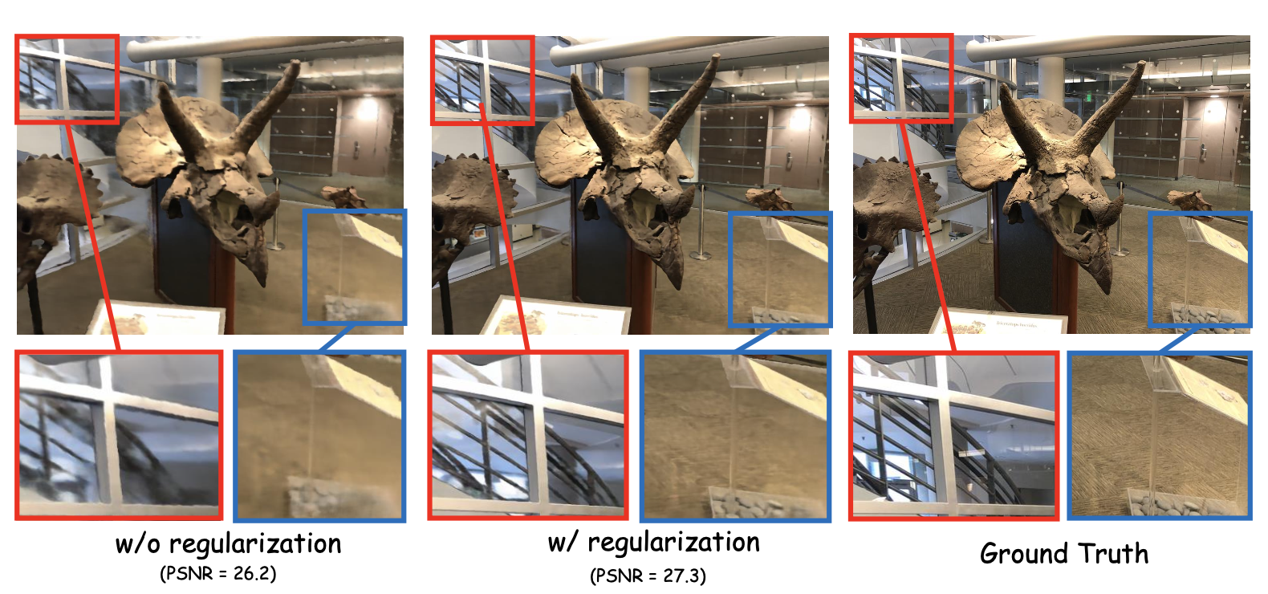
Regularization term effect

Slide 8
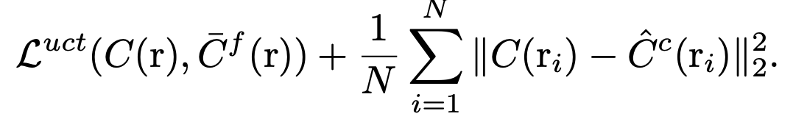
Final Loss
Fine model -> adopt the uncertainty branch
Coarse model -> same as vanila

Slide 9
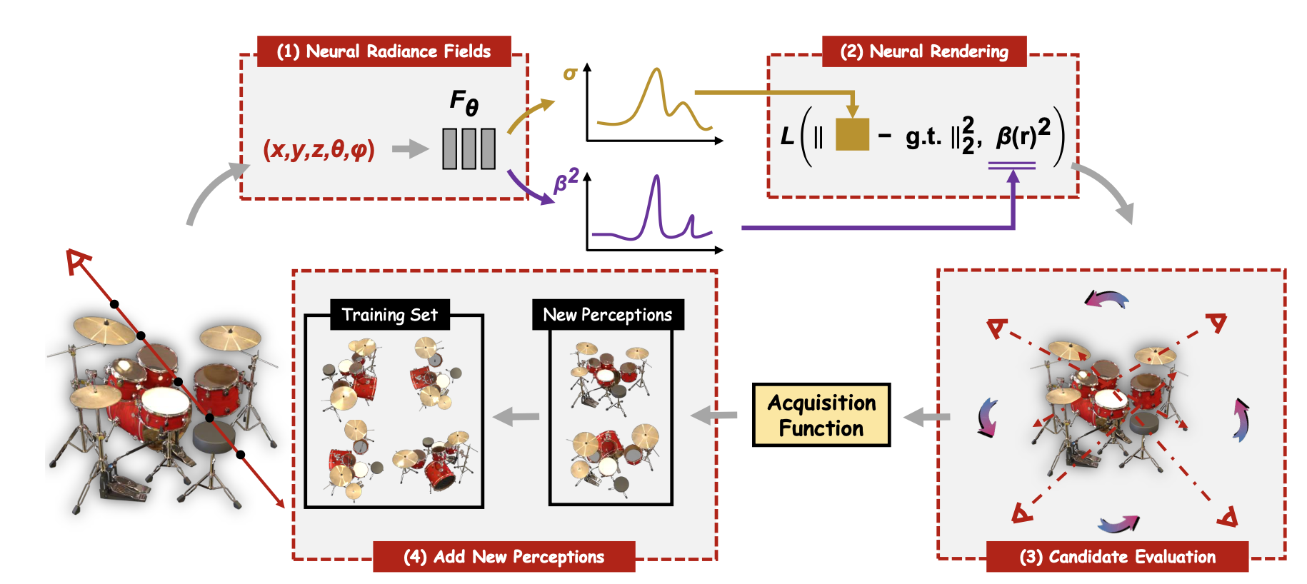
Why named active?
Inspired by the insights from active learning, ActiveNeRF try to supplement the training sample in the most efficient manner.

Slide 10
Acquisition Function
Using acquisition function, the captured new inputs bring the most information gain and promote the performance of the current model with the highest efficiency.
Can sample H/r×W/r rays to approximate the influence of the whole image with only 1/r2 time consumption.
Notes:
Prior and posterior distribution을 막 계산하고 그걸 고려해서 acquisition function을 정의하고 하는데, 사실 잘이해가 안됨…

Slide 11
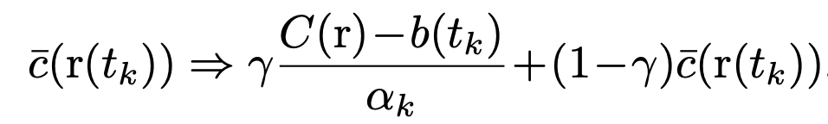
Two approaches to incorporate additional input
Bayesian Estimation.
-> With the ground-truth value C(r) from the new inputs, we can practically compute the posterior distribution
-> at inference time, we only need to substitute the prior color with the posterior Bayesian estimation
Continuous learning.
-> New inputs can be added to the training set and tune the model on the basis of the current one.
-> We can further control the fraction of training rays from new images, forcing the model to optimize in the newly observed regions.

Slide 12
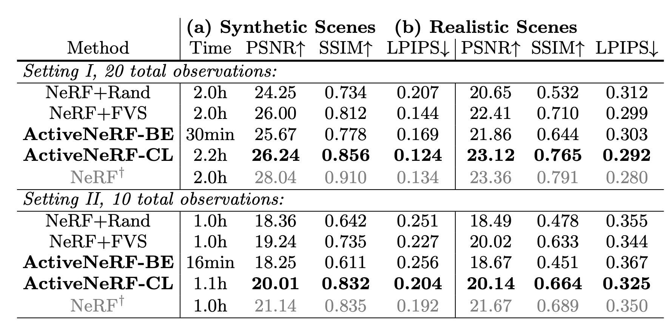
Experiment Result

Slide 13
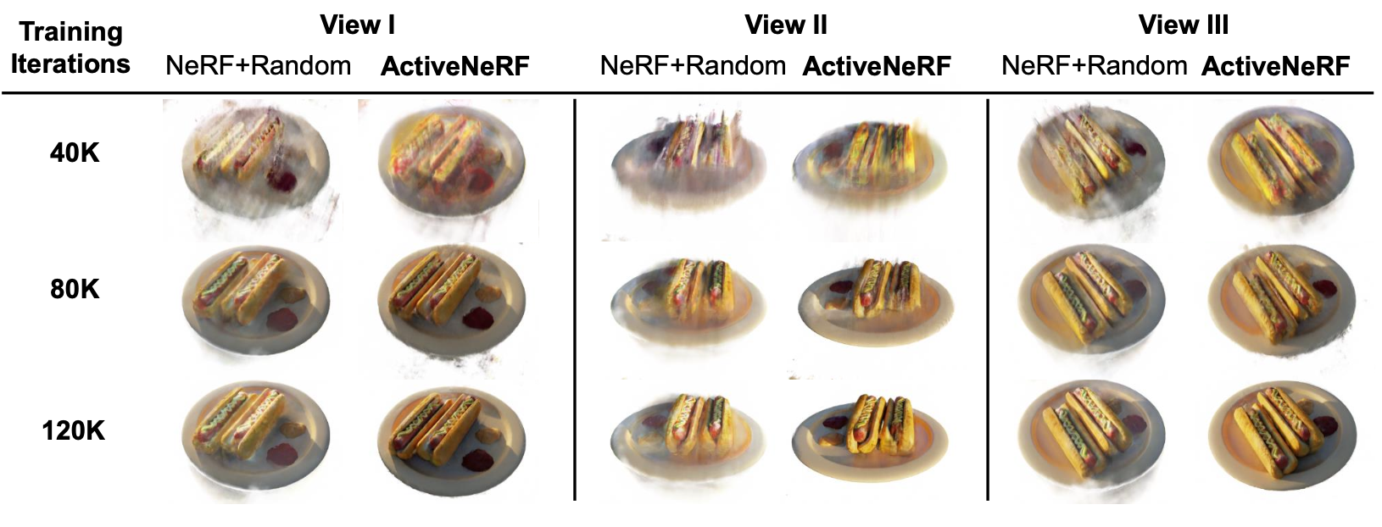
Experiment Result

Slide 15
Thank you for listening!
Notes:
Thank you for listening. Any question?

